Slide 2
Vocabulous

Slide 3



Team
David Hiebl
Backend-frontend interaction
Konstantin Urbanides
frontend
Maximilian Wahl
backend

Slide 4
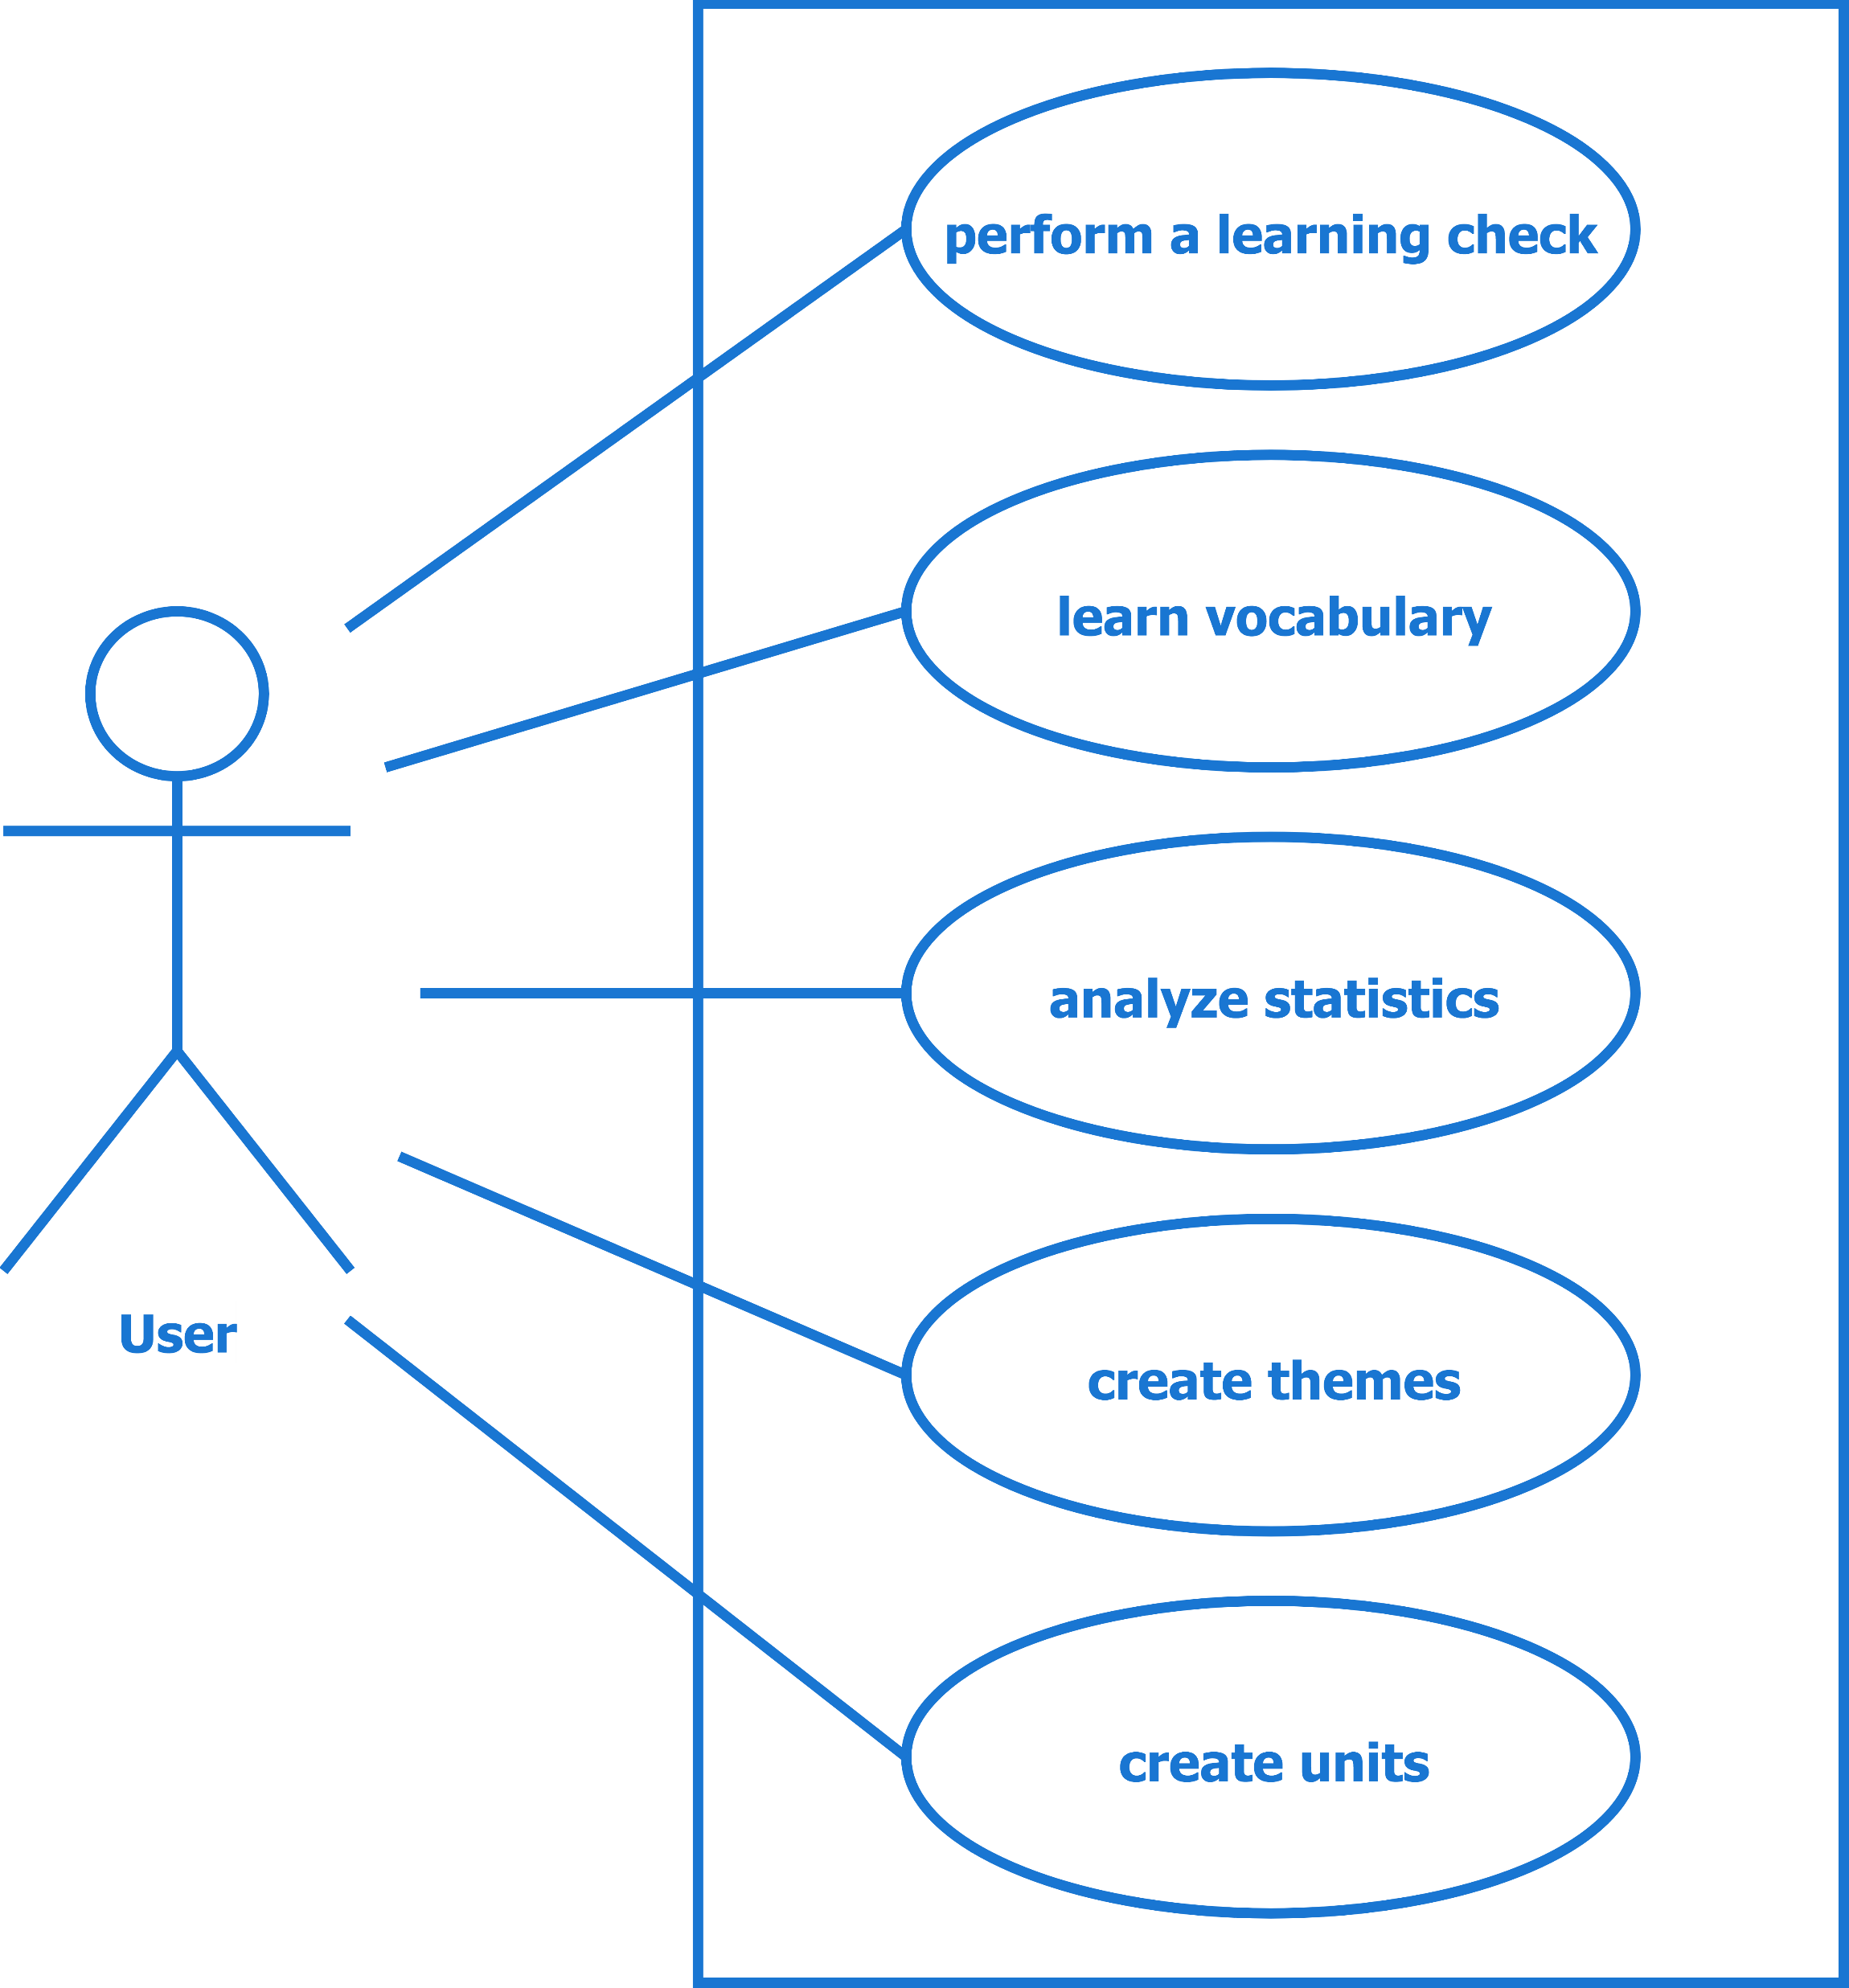
Use Cases

Slide 5
Have you already learned for the vocabulary test in five days?
Yes I have.
There is a new tool where you can learn vocabulary easily, called Vocabulous.
OK. Cool
I have to try it out.
You have to try it.
It‘s really awesome.

Slide 6

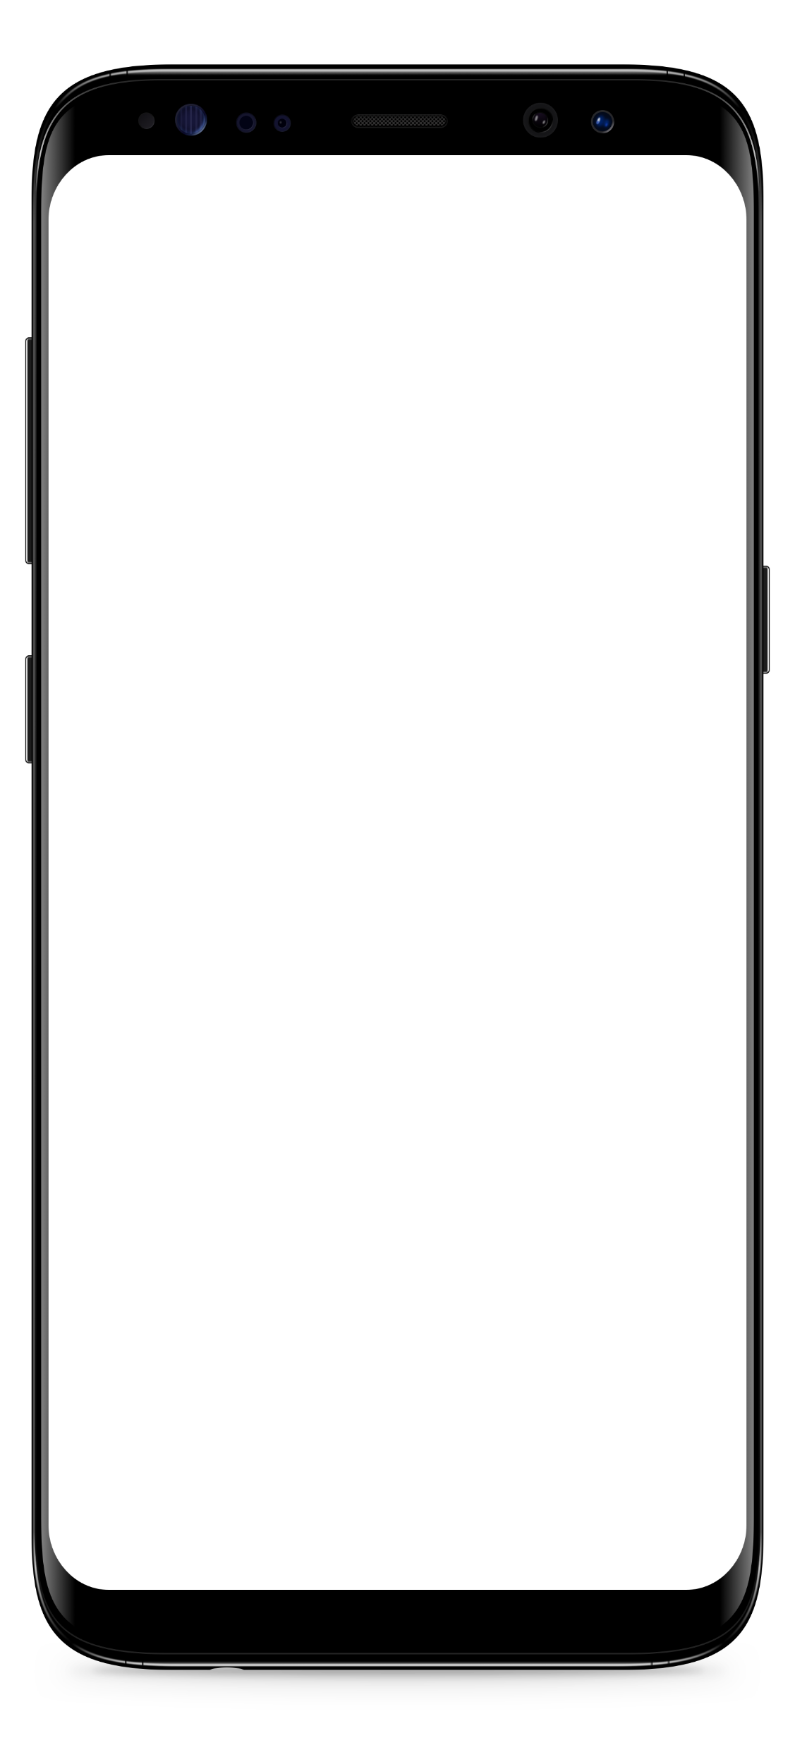
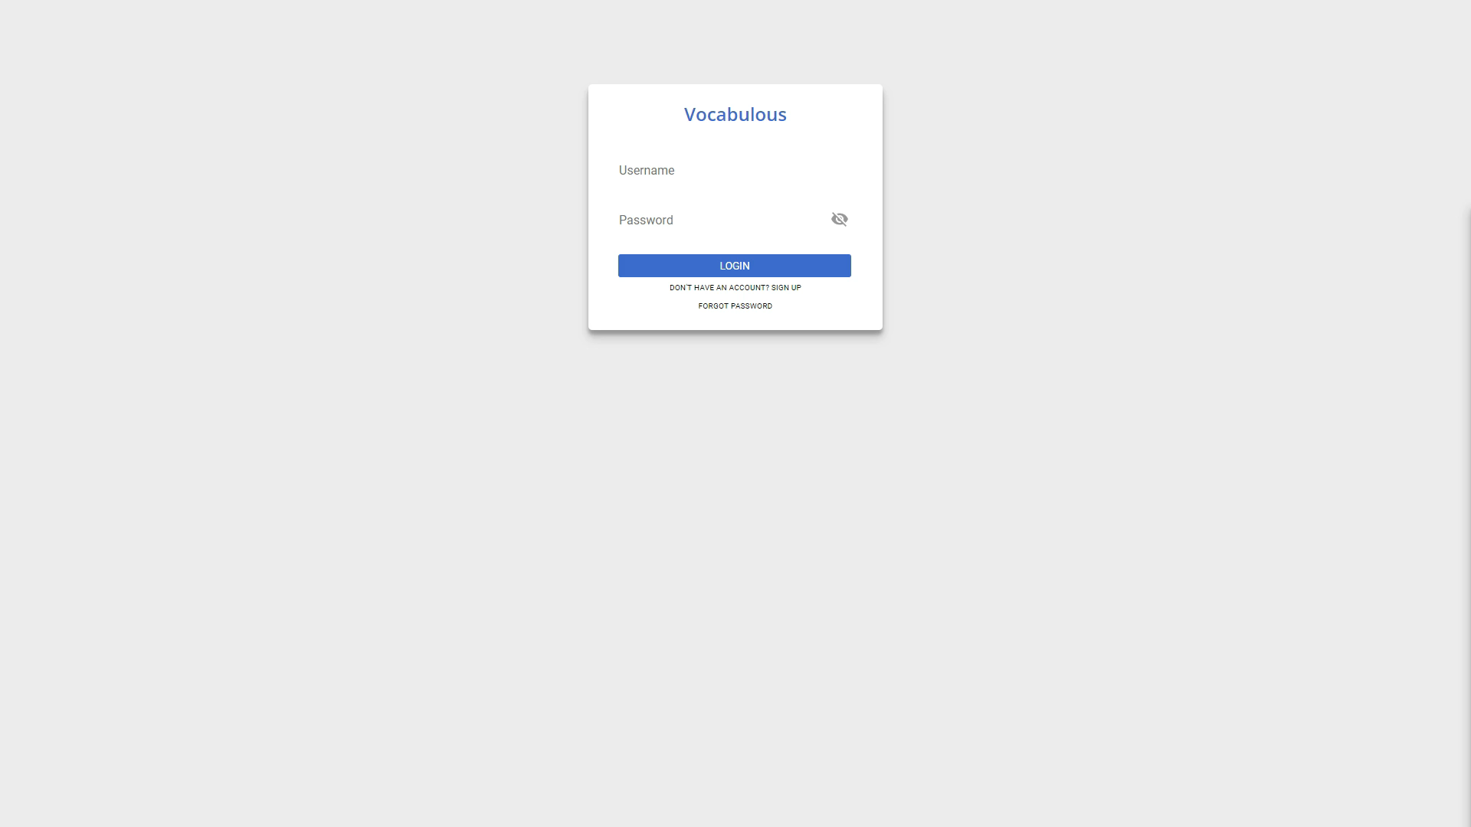
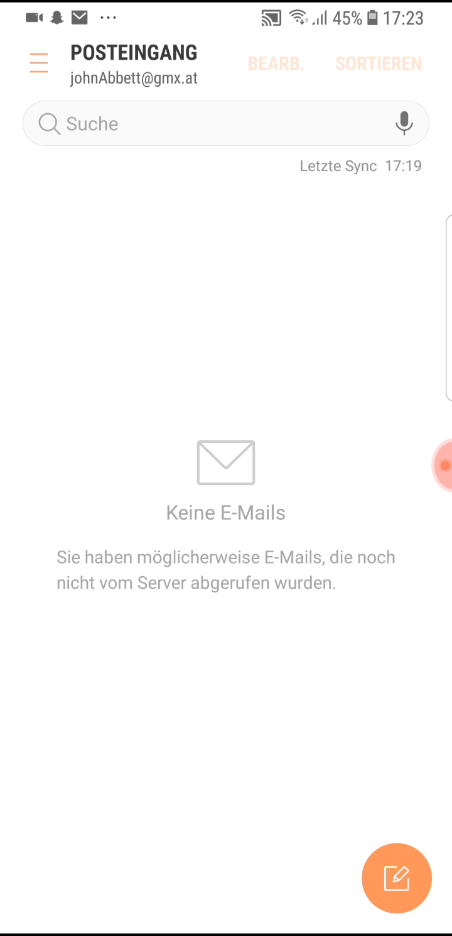
Register - Video

Slide 7
Features
clear and flat navigation structure
accurate and comprehensive presentation of learning outcomes

Slide 8
Features
temporal scalability of the statistical representation
user-defined customization of the program interface

Slide 9
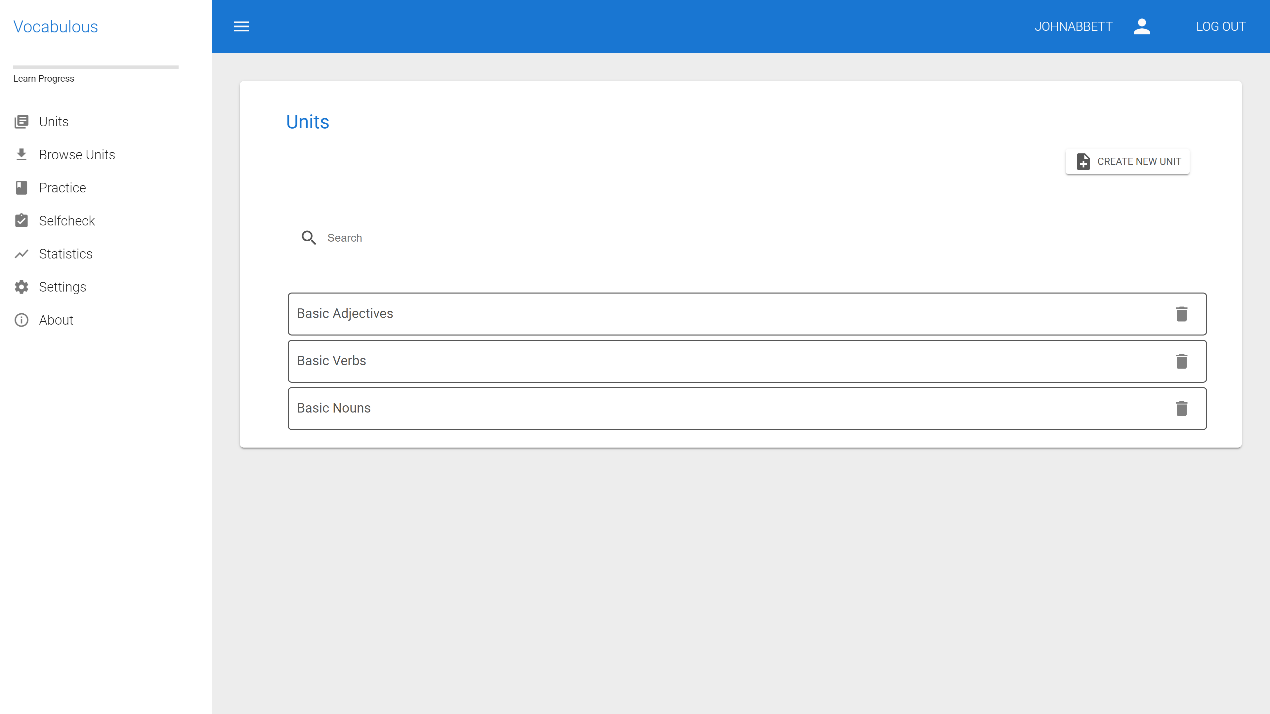

Slide 10

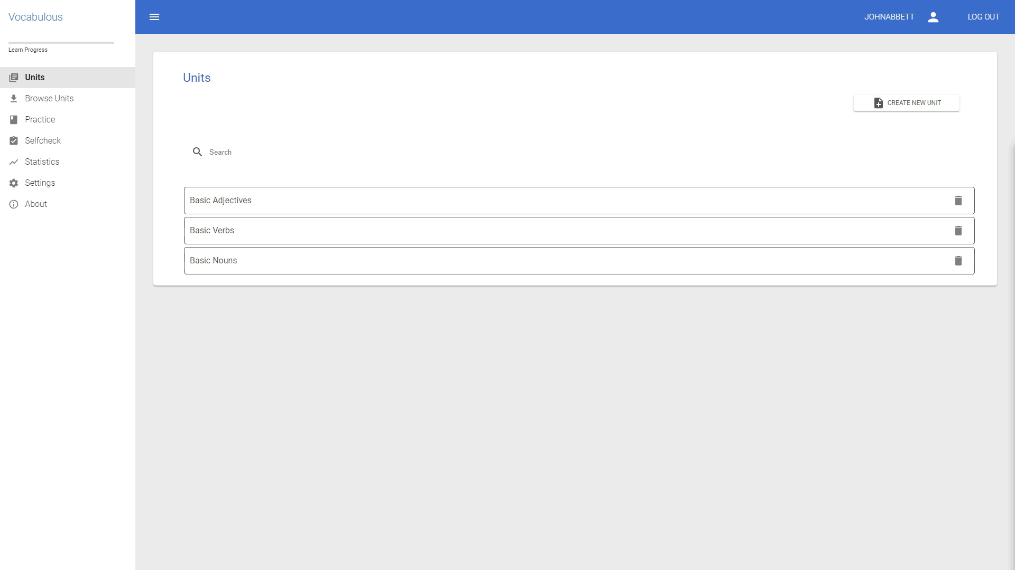
Units - Video

Slide 11
Do I have do write down the unit which comes to the vocabulary test myself?
No – of course not.
Take mine.
My username is mikesmith.
Ohh… that‘s nice.
Thanks

Slide 12

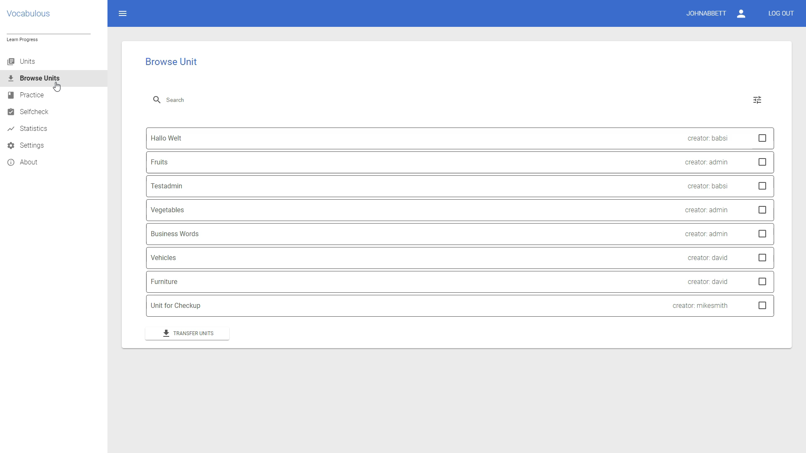
Browse - Video

Slide 13
Three days later…

Slide 14
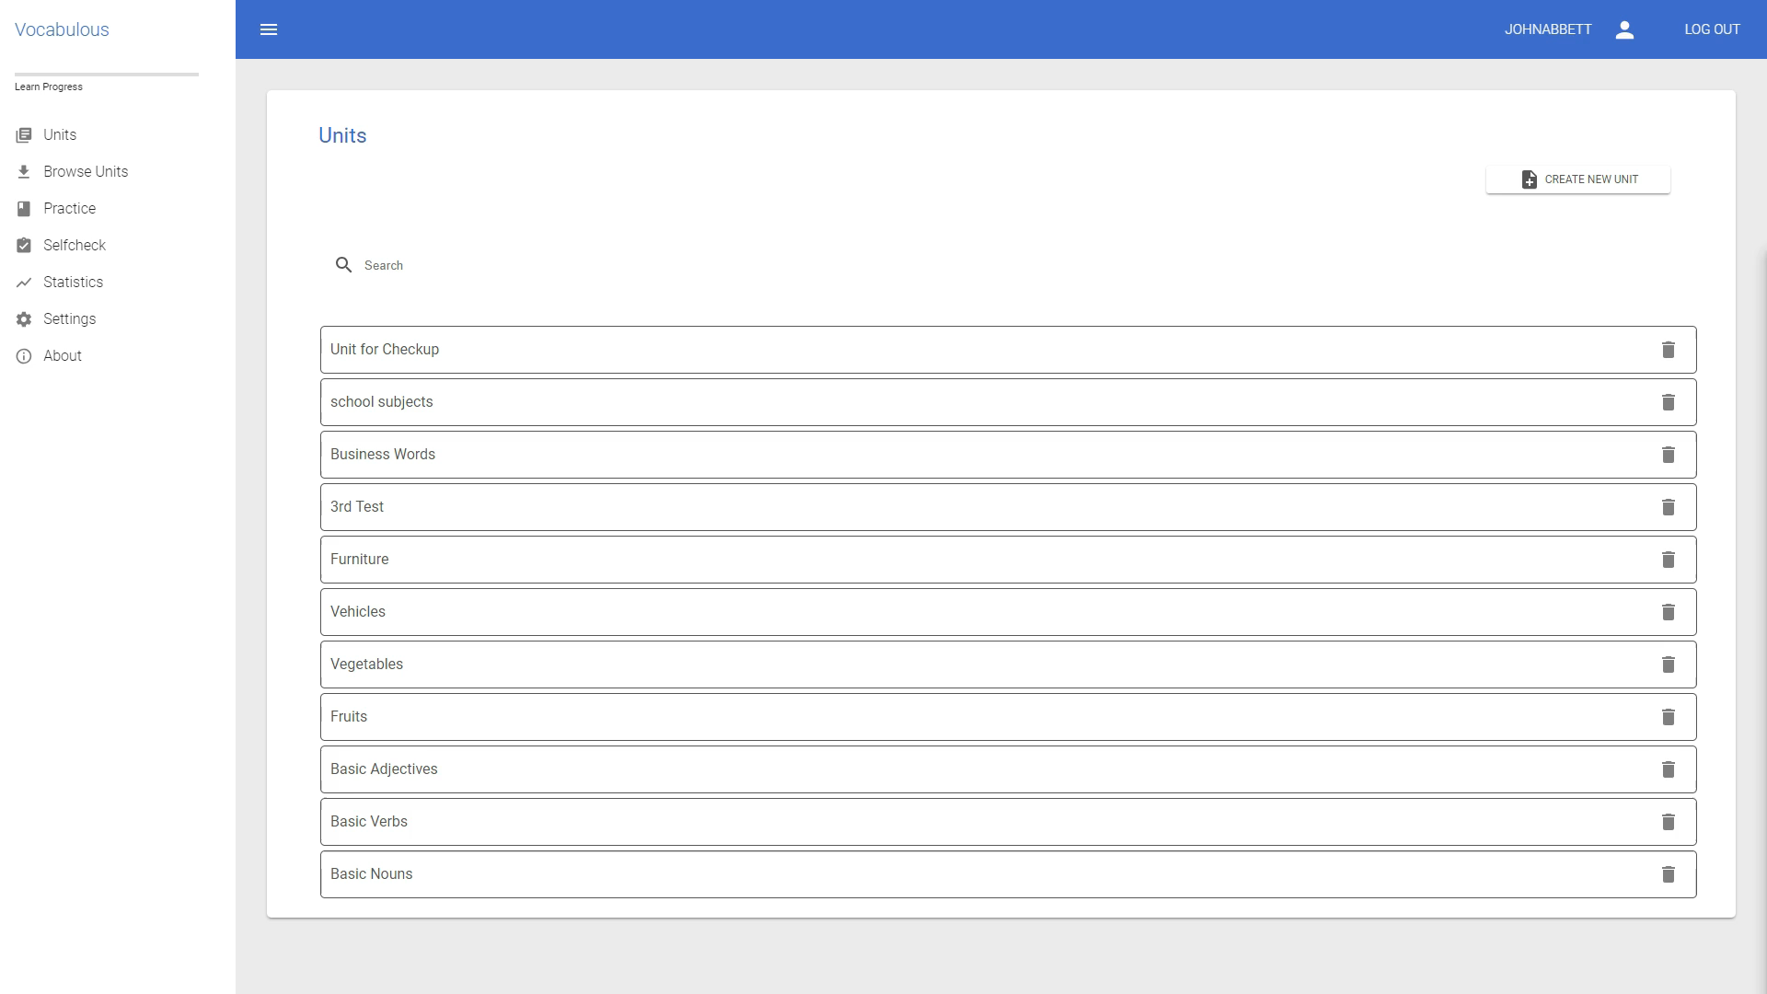
Practice - Statistic - Video

Slide 15
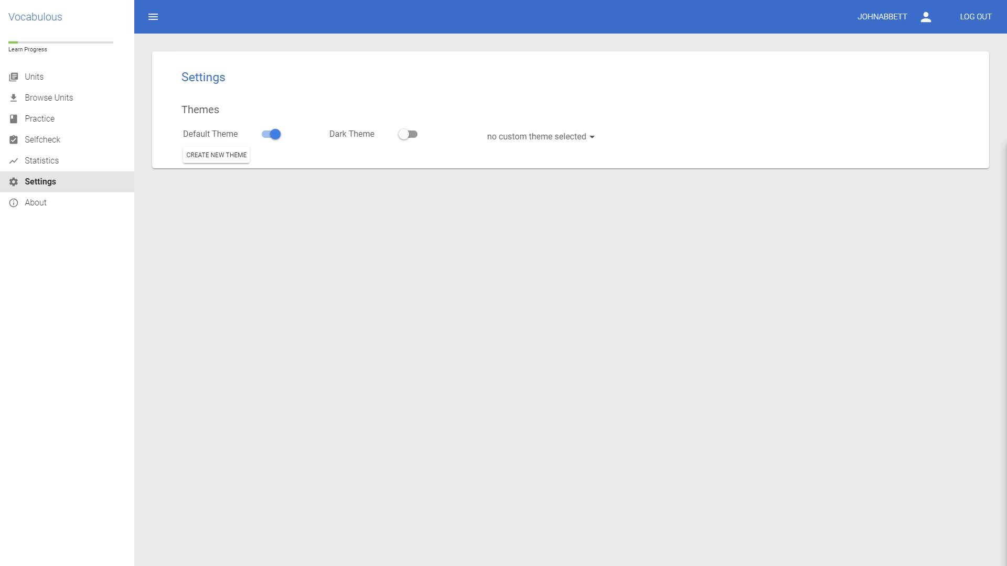
Creating Themes

Slide 16
Progressive Web App
Progressive
Responsive
App-like
Fresh

Slide 17


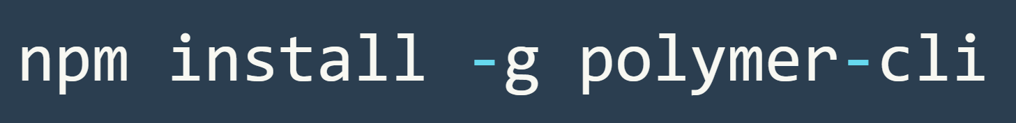
Polymer and WebComponents

Slide 18
JavaEE
dataserver
Web pages
RESTful Web Services
Source Packages
Test Packages
Other Sources
Dependencies
commons-lang-2.6.jar
derby-10.14.1.0.jar
javaee-web-api-7.0.jar
javax.mail-1.6.1.jar
javax.ws.rs-api-2.1.jar
jaxrs-cors-0.0.2.jar
activation-1.1.jar
Java Dependencies
Project Files
pom.xml
nb-configuration.xml

Slide 19
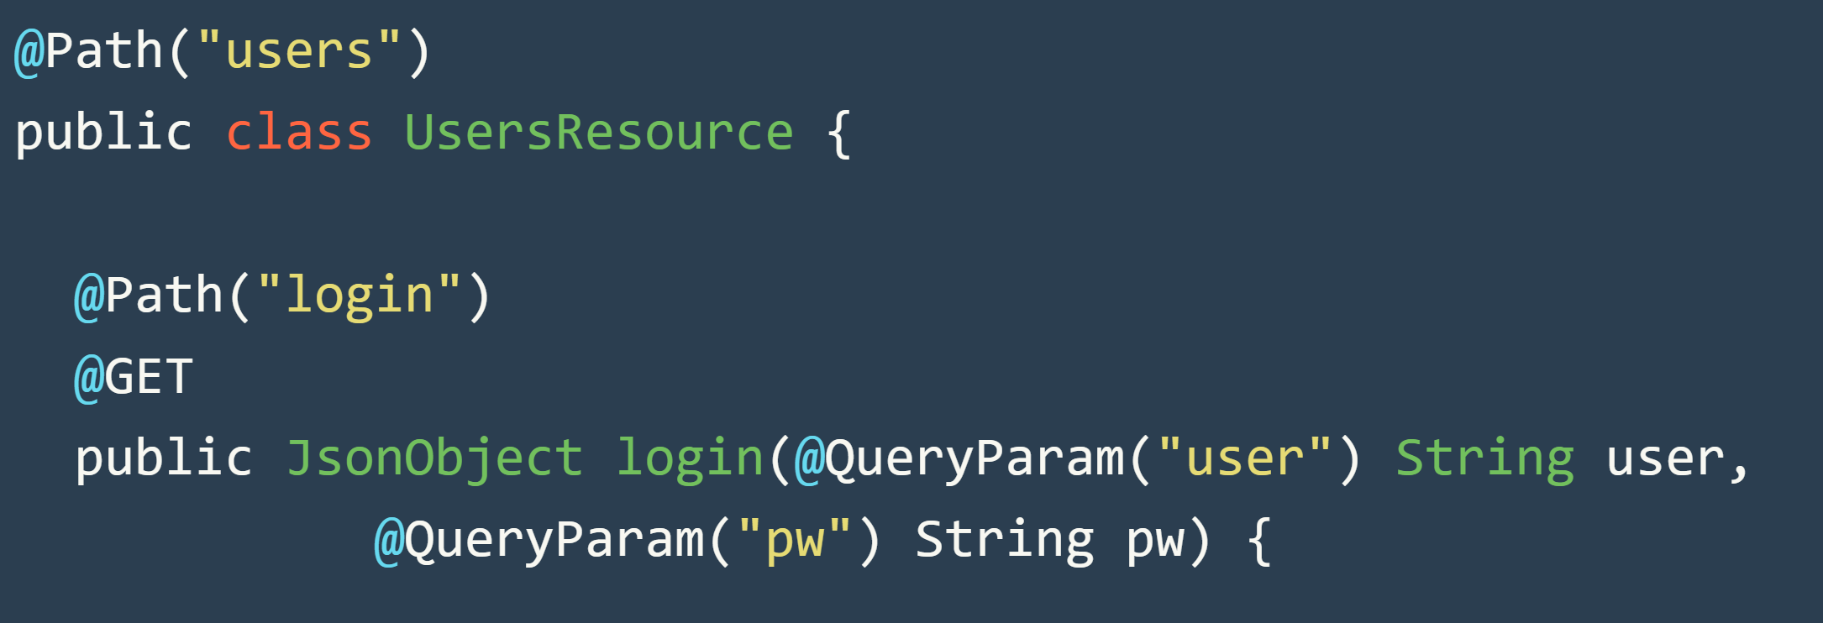
JavaEE

Slide 20
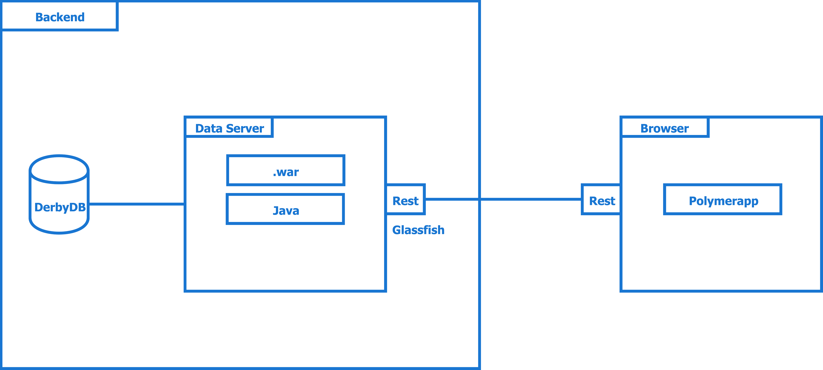
System Architecture

Slide 21
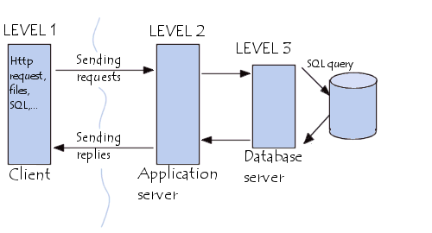
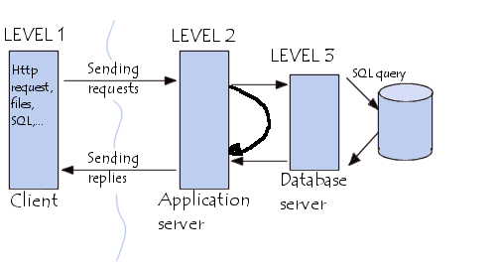
Three Layer Logic

